Slide 1
Inpatient Infusions for Acute Pain
APSEP
Oluwatobi Hunter, DNP, PMGT-BC, AGACNP-BC
January 23, 2024

Slide 2
Navigation and courses requirements
Information provided by ILEAD
How to Navigate the Course
Course Completion and Bookmarking
Estimated Duration: 20 to 30 minutes
Completion Requirements
Review each page of the module
Pass the posttest with a score of 80% or better

Slide 3
By the end of the module, you will be able to:
Describe the mechanism of action for intravenous ketamine and intravenous lidocaine for acute pain.
Identify appropriate patient selection for intravenous infusions for acute pain.
Discuss the safety and monitoring of patients receiving intravenous infusions for acute pain.
Review opportunities and obstacles to implementing acute pain infusions.
3

Slide 4
We will review:
Topic One: Ketamine infusions for acute pain.
Topic Two: Lidocaine infusions for acute pain.
Topic Three: Implementing infusions for acute pain at your facility.
4

Slide 5

TOPIC ONE: Intravenous Ketamine Infusions for Acute Pain
5

Slide 6
What is ketamine?
Introduced clinically in 1970 as a dissociative anesthetic
Subanesthetic (low-dose) intravenous ketamine is used for pain relief
Mion, G. (2017). Eur. J. Anaesthesiol, 34(9), 571-575.
6

Slide 7
Low-dose Ketamine
Provides analgesia
Reduces hyperalgesia
Potentiates the analgesic effects of opioids
Opioid-spearing effects
Preserves respiratory function and airway reflexes
Gorlin, A. (2016). J. Anaesthesiol. Clin. Pharmacol, 32(2), 160–167.
Vadivelu, N. (2016). J. Anaesthesiol. Clin. Pharmacol, 32(3), 298-306.
7

Slide 8
Ketamine Mechanism of Action
Primary drug effect:
N-methyl-D-aspartate (NMDA) receptor inhibition
Secondary drug effects:
Opioid receptor agonist
Anti-inflammatory effects
Niesters. (2014). Br J Clin Pharmacol, 77(2), 357-367.
Vadivelu, N. (2016). J Anaesthesiol Clin Pharmacol, 32(3), 298-306.
8

Slide 9

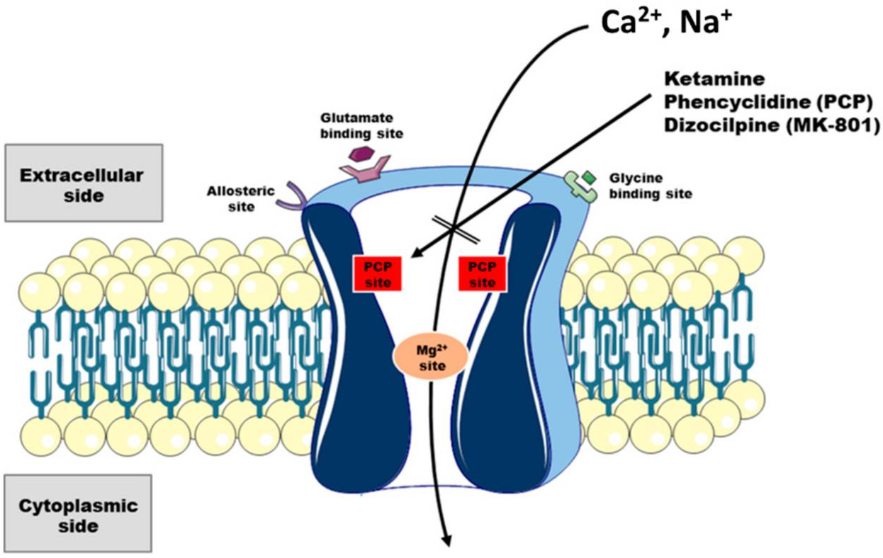

NMDA Receptor Antagonism
Ketamine binds non-competitively to the NMDP receptor
Reduces glutamate release
Blocks calcium influx to inhibit neurotransmission
Adapted from Lisek M. (2020). Int J Mol Sci, 21(21):8410.

Slide 10
Ketamine Pharmacology
Dose-dependent analgesic, amnesic, and anesthetic effects
Highly lipophilic and rapidly crosses the blood-brain barrier
Half-life: 2-3 hours
Hepatically metabolized to active and inactive metabolites
Excreted in urine and stool
Niesters. (2014). Br J Clin Pharmacol, 77(2), 357-367.
Vadivelu, N. (2016). J Anaesthesiol Clin Pharmacol, 32(3), 298-306.
10

Slide 11
Ketamine Indications
Acute pain associated with moderately to severely painful surgery (e.g., thoracic, major abdominal, or major orthopedic)
Opioid-experienced patients
Patients at risk for opioid-related adverse events (e.g., asthma, sleep apnea, home oxygen, substance misuse)
Non-operative patients with severe acute pain or palliative care refractory to multimodal analgesics
Niesters. (2014). Br J Clin Pharmacol, 77(2), 357-367.
Vadivelu, N. (2016). J Anaesthesiol Clin Pharmacol, 32(3), 298-306.
11

Slide 12
Ketamine Patient Selection
Contraindications:
Relative Contraindications:
Ketamine hypersensitivity
Uncontrolled hypertension
Severe hepatic dysfunction
Pregnancy
Active psychosis
Poorly controlled psychiatric disorder
Catecholamine depletion (e.g., sepsis)
Psychiatric disorder with hallucinations or nightmares
Elevated intracranial pressure
Elevated intraocular pressure
Cardiovascular disease for which elevated blood pressure may be dangerous
Current or prior ketamine misuse
CRE_Ketamine_Infusion_for_the_Treatment_of_Intractable_Neuropathic_Pain.pdf (va.gov)
Gorlin, A. (2016). J. Anaesthesiol. Clin. Pharmacol, 32(2), 160–167.
Niesters, N. (2014). Br. J. Clin. Pharmacol, 77(2), 357-367.

Slide 13
Adverse effects
 | Ketamine n=35 n | (%)Placebo n=35n (%) | p value
Nausea | 17 (49) | 14 (40) | 0.47
Vomiting | 8 (23) | 8 (23) | 1
Pruritus | 12 (34) | 13 (37) | 0.8
Sedation | 18 (51) | 15 (43) | 0.47
Lightheadedness | 14 (40) | 5 (14) | 0.02
Vivid dreams | 13 (40) | 2 (6) | 0.001
Chumbley GM. (2019). Eur J Pain, 23(5):985-993.
13

Slide 14
Other Adverse Effects
Psychomimetic effects are dose-dependent
Less common with doses under 30mg/hr
Treat with alpha-2 agonists or benzodiazepines
Excessive salivation
Stop ketamine if patient is unable to protect airway
Central sympathetic stimulation
Hypertension and tachycardia
Direct myocardial depression
More common at anesthetic doses or catecholamine depletion
Cystitis
Associated with illicit use or chronic use
Cohen, S. (2018). Reg Anesth Pain Med, 43(5), 521-546. Niesters, N. (2014). Br. J. Clin. Pharmacol, 77(2), 357-367.
CRE_Ketamine_Infusion_for_the_Treatment_of_Intractable_Neuropathic_Pain.pdf (va.gov)
14

Slide 15
Ketamine Prescribing
Avoid standing titration orders outside of critical care settings
Loading bolus at the start of the infusion must be administered by an anesthesia provider, or someone credentialed with the routine use of ketamine, followed by direct observation for at least 30 minutes
Follow your facility’s controlled substance policy and medication policy
Hunter OO. (2023). J Am Assoc Nurse Pract, 35(2):98-103.
VHA Directive 1073 (1) Appendix E “Parameters for the Safe Administration of Ketamine for Non-Sedation Purposes” January 13, 2023
15

Slide 16
Ketamine Dosing Recommendations
Must use ideal body weight
Optional loading bolus: 0.2-0.5 mg/kg
Not necessary if continuing intraoperative infusion
Initiate at 0.1-0.2 mg/kg/hr IBW
Titrate by 0.1 mg/kg/hr IBW based on analgesia and side effects
Hunter OO. (2023). J Am Assoc Nurse Pract, 35(2):98-103.
VHA Directive 1073 (1) Appendix E “Parameters for the Safe Administration of Ketamine for Non-Sedation Purposes” January 13, 2023
16

Slide 17
Ketamine Dosing Recommendations cont.
Consider intraoperative dosing recommendations for enhanced recovery after surgery (ERAS) protocols
Consider setting a maximum infusion dose on medical-surgical units
Hunter OO. (2023). J Am Assoc Nurse Pract, 35(2):98-103.
VHA Directive 1073 (1) Appendix E “Parameters for the Safe Administration of Ketamine for Non-Sedation Purposes” January 13, 2023
17

Slide 18
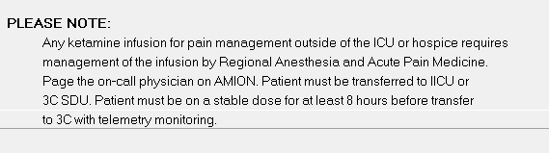
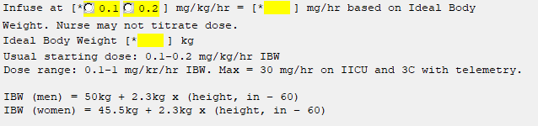
IV Ketamine Sample Order Set Part 1
VA Palo Alto HCS
18

Slide 19
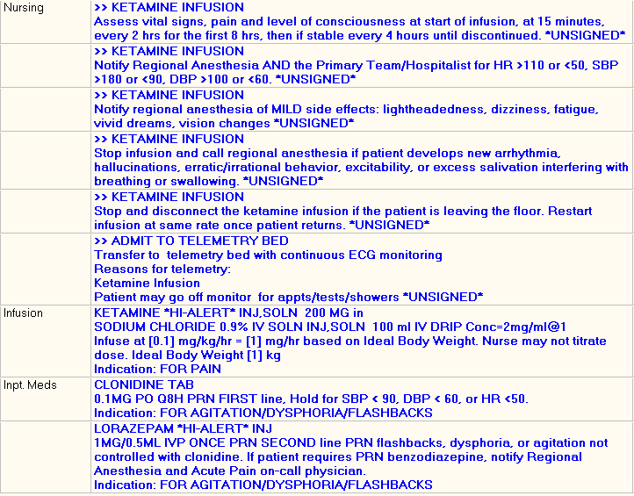
IV Ketamine Sample Order Set Part 2
VA Palo Alto HCS
19

Slide 20
Monitoring & Documentation
Vital signs, pain score, and sedation scale:
At the start of the infusion
At 15 minutes
Every 1 hr for the first 4hrs
Then if stable every 4hrs until discontinued
Telemetry optional if dose < 0.5mg/kg/hr IBW
Frequency of monitoring should be facility-specific
Hunter OO. (2023). J Am Assoc Nurse Pract, 35(2):98-103.
VHA Directive 1073 (1) Appendix E “Parameters for the Safe Administration of Ketamine for Non-Sedation Purposes” January 13, 2023
20

